Slide 1
EVALUATION ORIENTATION
THE JORDAN PERFORMANCE APPRAISAL SYSTEM
JPAS 2022 - 2023

Slide 2
UTAH EDUCATION EVALUATION LAW (53A- 8A-301)
The law requires that all educators be evaluated annually.
Provisional/Probationary: Full UETS-based JPAS annually
Career: Full UETS-based JPAS every third year; an interim evaluation will be completed when not on a full evaluation

Slide 3
EDUCATOR EVALUATION AND YOU
The Utah Educator Evaluation Law mandates that you:
Be evaluated with a reliable and valid evaluation.
Be oriented to the evaluation process prior to being evaluated.
Receive personal notification of the evaluation process at least 15 working days prior to your first evaluation.
Be assigned a mentor educator if you are a provisional teacher
Continued . .

Slide 4
Be allowed to make a written response to all or any part of the evaluation and have that response attached to the evaluation.
A copy of the evaluation and attachments will be given or made accessible to you.
This is your orientation and notification of evaluation this year.

Slide 5
PROFESSIONAL PRACTICES FOR HIGH
QUALITY INSTRUCTION & LEADERSHIP
The Jordan Performance Appraisal System (JPAS)
The UETS-based JPAS is an evaluation system dedicated to the recognition and development of professional educator skills. The system is based on standards of effective practices.

Slide 6
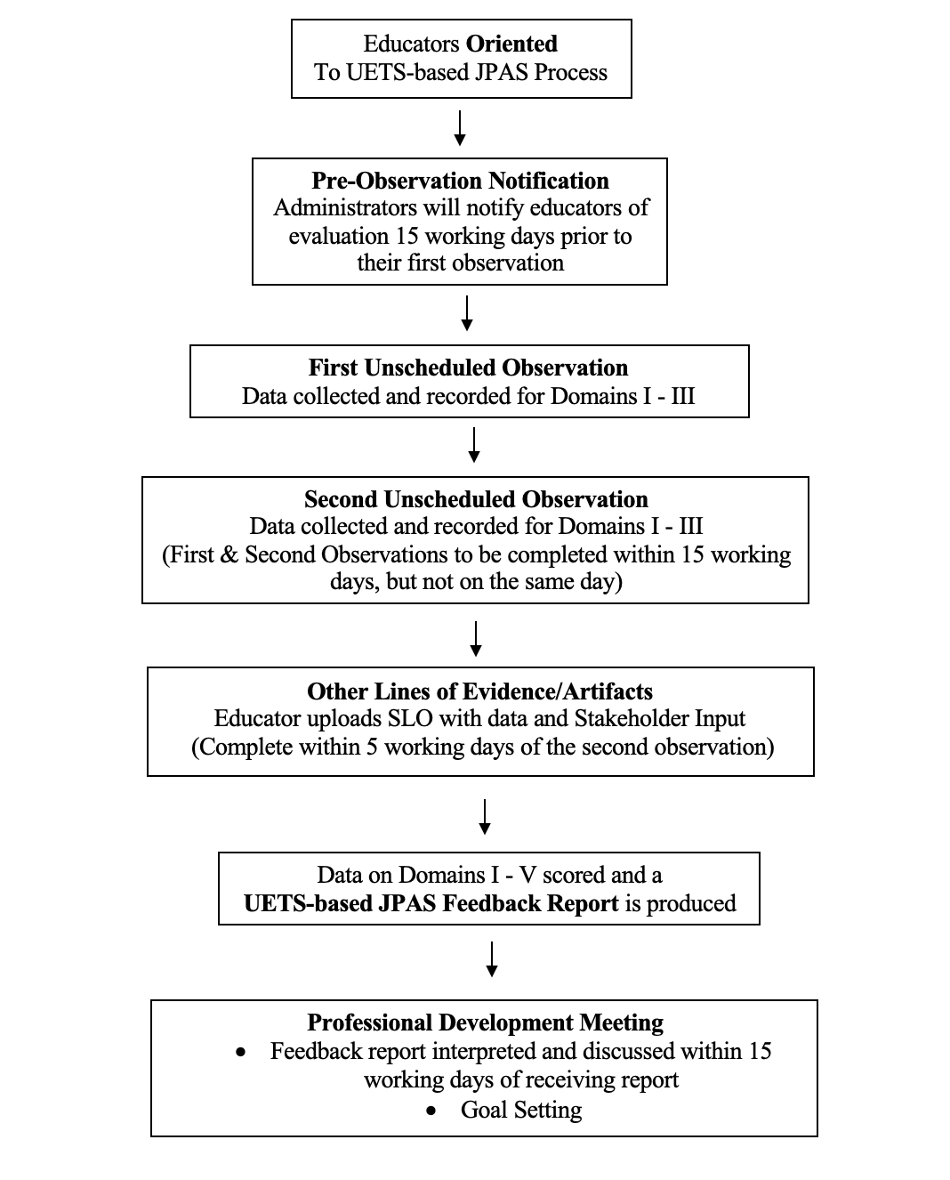
EVALUATION PROCESS
Provisional educators will go through the cycle yearly.
Career educators will go the cycle every third year.

Slide 7
THE COMPONENTS OF T HE
UETS-BASED JPAS ARE:
The Observation System
Evidence requirement: student growth & stakeholder input
A Feedback Report
The Professional Development Meeting and Materials
Educator Interim Evaluation (for career educators for use during Interim Evaluation years)
More information is available for all employee evaluations on the Jordan Evaluation Systems website http://jes.jordandistrict.org/

Slide 8
OBSERVATION REQUIREMENTS
Two UNSCHEDULED observations
At least 30 minutes of observable time each

Slide 9
THE OBSERVATION SYSTEM
The classroom observation contains 25 indicators and are divided up into the following domains.
Managing the Classroom - indicators 1 - 3
Delivering Instruction - indicators 4-17
Interacting with Students - indicators 18-25
These indicators are recorded on the inside of an Observation Form. The decision rules for the indicators are on page 1-49 of the Domains Document.

Slide 10
STUDENT GROWTH & STAKEHOLDER INPUT
Required evidence to be uploaded into the Perform system under the evidence tab.
Student growth
SLO with data
Stakeholder input
Climate survey results

Slide 11
OTHER SUBGROUP EVALUATIONS
All evaluations for the following subgroups will be found on the Perform system.
Teacher Specialist
Counselor
Social Workers
Health & Wellness
Psychologists
Media Specialists

Slide 12
NOT EFFECTIVE (0) indicates a performance which has not met the standard for successful teaching in Jordan School District
MINIMALLY EFFECTIVE (1) indicates a performance which has met the standard and identifies strengths and weaknesses to be considered in developing plans to improve performance
EFFECTIVE (2) indicates a performance which has met the standard and identifies strengths and weaknesses to be considered in developing plans to enhance performance
HIGHLY EFFECTIVE (3) indicates a performance which has met the standard and identifies areas in which you excelled

Slide 13
UTAH STATE LAW & COMPENSATION
According to Utah State Law 53A-8a-602 and the associated Utah State Board of Education Rule (R277-533), any educator that receives a level of performance in the ‘not effective’ range will not advance on the adopted wage or salary schedule.
There are four exceptions to the above.
Provisional Status (1-3 years)
New to the School (1 year)
New to the grade (1 year)
All new preps (secondary – 1 year)

Slide 14
District Policy
The District Policy for educator evaluation is DP311 Evaluation of Licensed Personnel can accessed online at: http://policymanual.jordandistrict.org/

Slide 15
THE PROFESSIONAL DEVELOPMENT MATERIALS
http://jes.jordandistrict.org/educators/resources/pdm/
http://jes.jordandistrict.org/files/ColorCodedJPAS-Domains-IV-and-V
A companion to the measurement portion of the UETS-based JPAS
A set of activities and materials designed to help educators enhance their skills
Organized by the domains and their subcategories
Ideas/Suggestions are given for every indicator
To be used in conjunction with the professional development meeting

Slide 16
HELP RESOURCES
The Professional Development Materials
Assistance from a specially trained Consulting Educator (A Consulting Educator may be requested at anytime by any teacher, not just for help concerning UETS-based JPAS.)
Assistance from your school administration
Assistance from a school mentor, lead mentor, and/or instructional coach
District sponsored UETS-based JPAS classes on Canvas

Slide 17
WHAT HAPPENS IF YOUR TOTAL SCORE FROM AN EVALUATION IS IN THE
NOT EFFECTIVE RANGE?

Slide 18
An administrator may choose to complete a full evaluation for an educator at any time. This will change the evaluation cycle for this educator.

Slide 19
EVALUATOR CERTIFICATION
Prior to completing a UETS-based JPAS evaluation administrators must pass a certification course.
Administrators must recertify in the use of the UETS-based JPAS once every three years after their initial certification.
The UETS-based JPAS is monitored annually.

Slide 20
CONCLUSION
The feedback you receive from a UETS-based JPAS (observations/interview or interim) will:
Give you recognition for the effective skills you use
Help you identify areas for professional growth goals
Aid in providing high quality instruction to all students

Slide 21
FOR MORE INFORMATION…
Everyone is welcome to review all evaluation information found in the Canvas course
New hires are highly encouraged to review evaluation information
http://jes.jordandistrict.org/educators/trainings/

